Slide 1
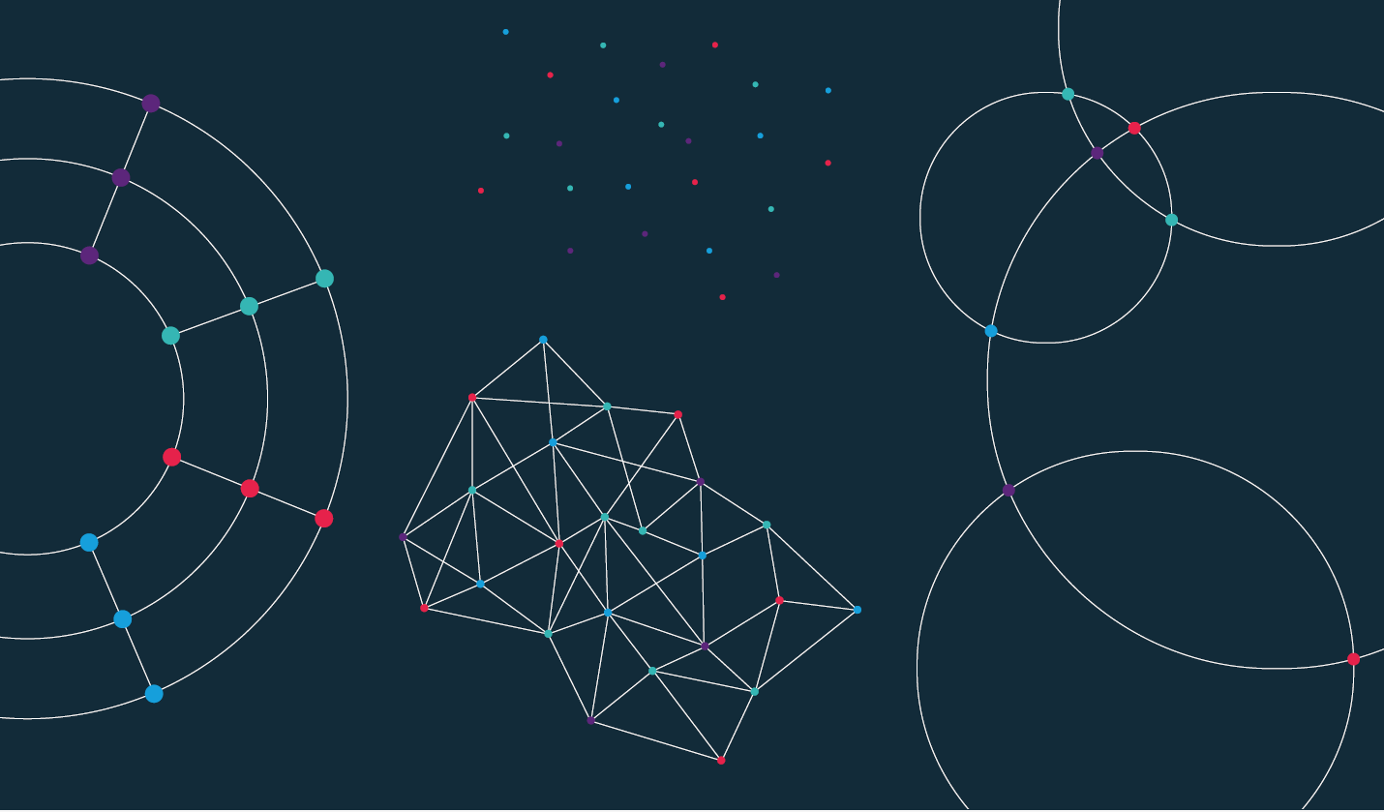

Slide 2
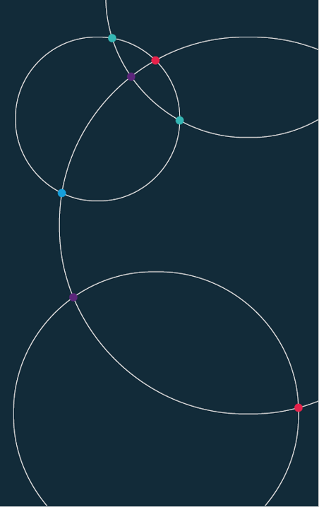
Data Science. Week 9. University of Bristol Autumn 2024

Slide 3
Week 9.
Review of data skills so far.
Relationships. Correlation.
Regression.
Code-along (unsupervised learning):
Clustering.
Dimensionality reduction.

Slide 4
Week 11.
Code-along (supervised learning):
Classification.
Fancy regressions.

Slide 5
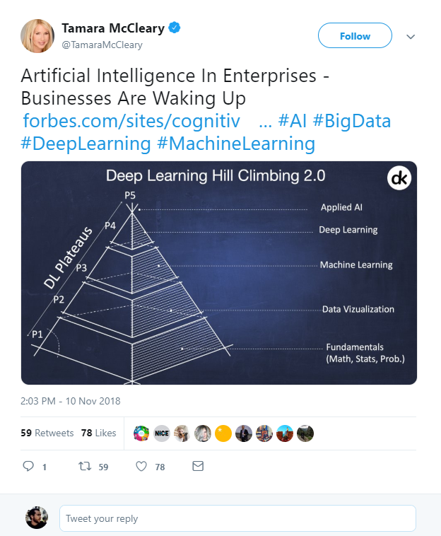
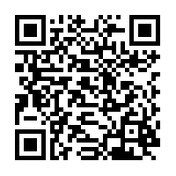
What is Data Science?
Artificial Intelligence?
Machine Learning?
Deep Learning?
Big Data?
https://twitter.com/TamaraMcCleary/status/1061197523610550272
Notes:
Tamara MCcleary – Tech Influencer
The data science pyramid
What do some of the more “fashionable” terms mean?
https://twitter.com/TamaraMcCleary/status/1061197523610550272

Slide 6
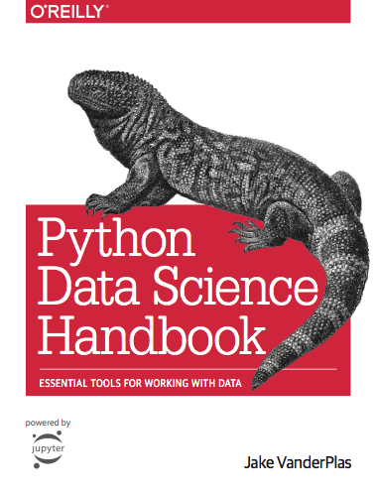
Data Science Handbook.
Jake VanderPlas.
UW | Google.
Introduction of Python.
Best introductory resource.
https://jakevdp.github.io/PythonDataScienceHandbook/
Notes:
http://vanderplas.com/
https://jakevdp.github.io/PythonDataScienceHandbook/
https://escience.washington.edu/people/jake-vanderplas/

Slide 7
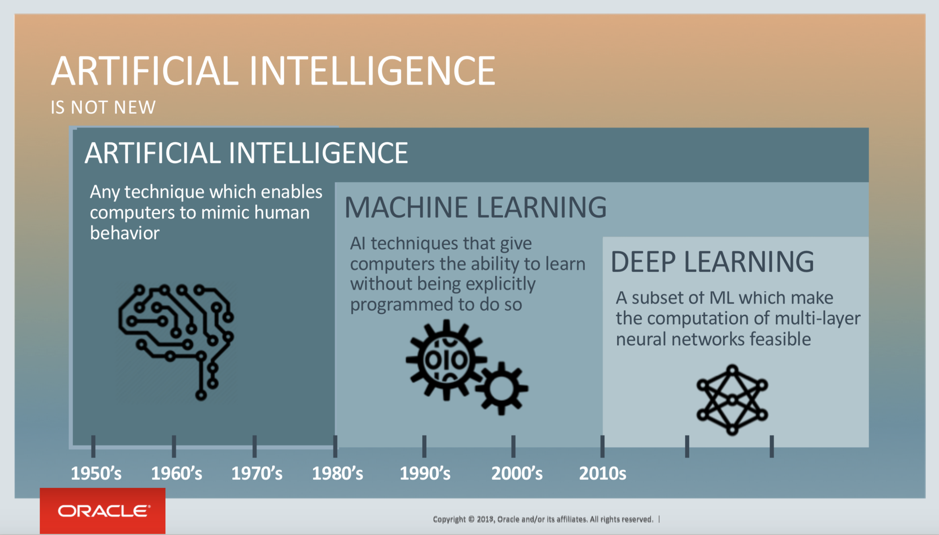
Notes:
https://blogs.oracle.com/bigdata/post/whatx27s-the-difference-between-ai-machine-learning-and-deep-learning

Slide 8


Slide 9
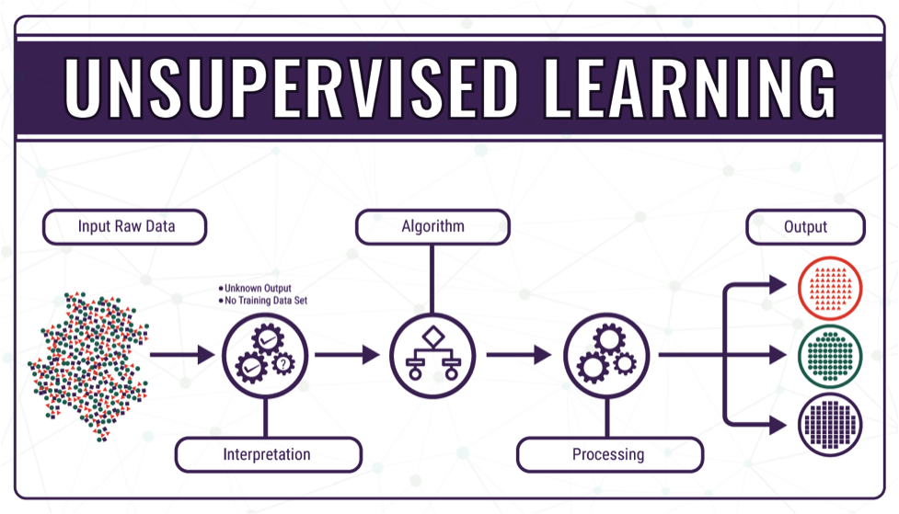
Notes:
https://bigdata-madesimple.com/machine-learning-explained-understanding-supervised-unsupervised-and-reinforcement-learning/

Slide 10
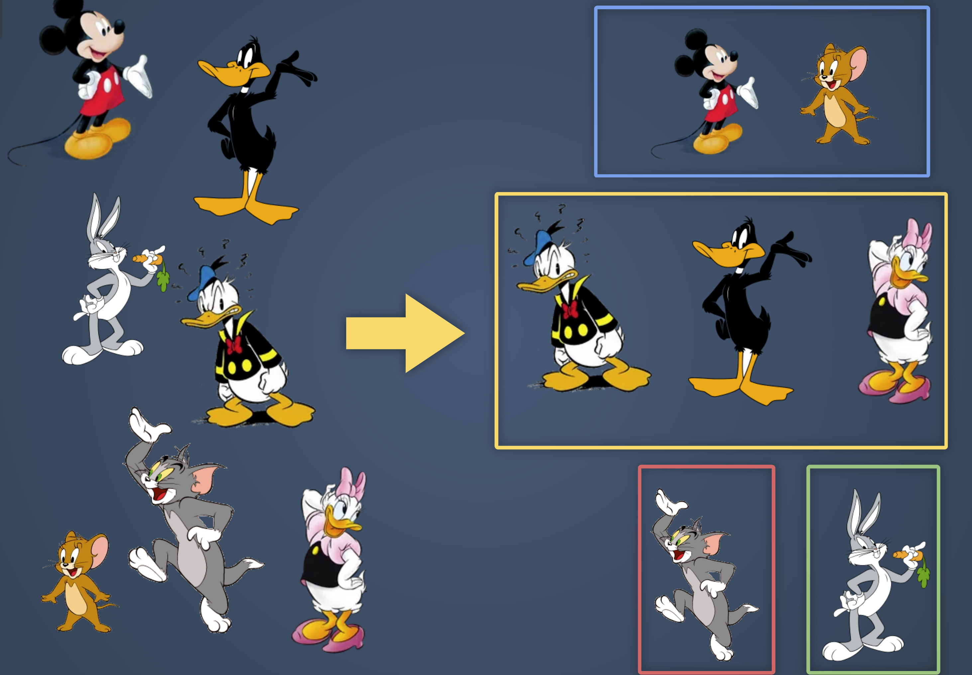
Notes:
https://bigdata-madesimple.com/machine-learning-explained-understanding-supervised-unsupervised-and-reinforcement-learning/

Slide 11
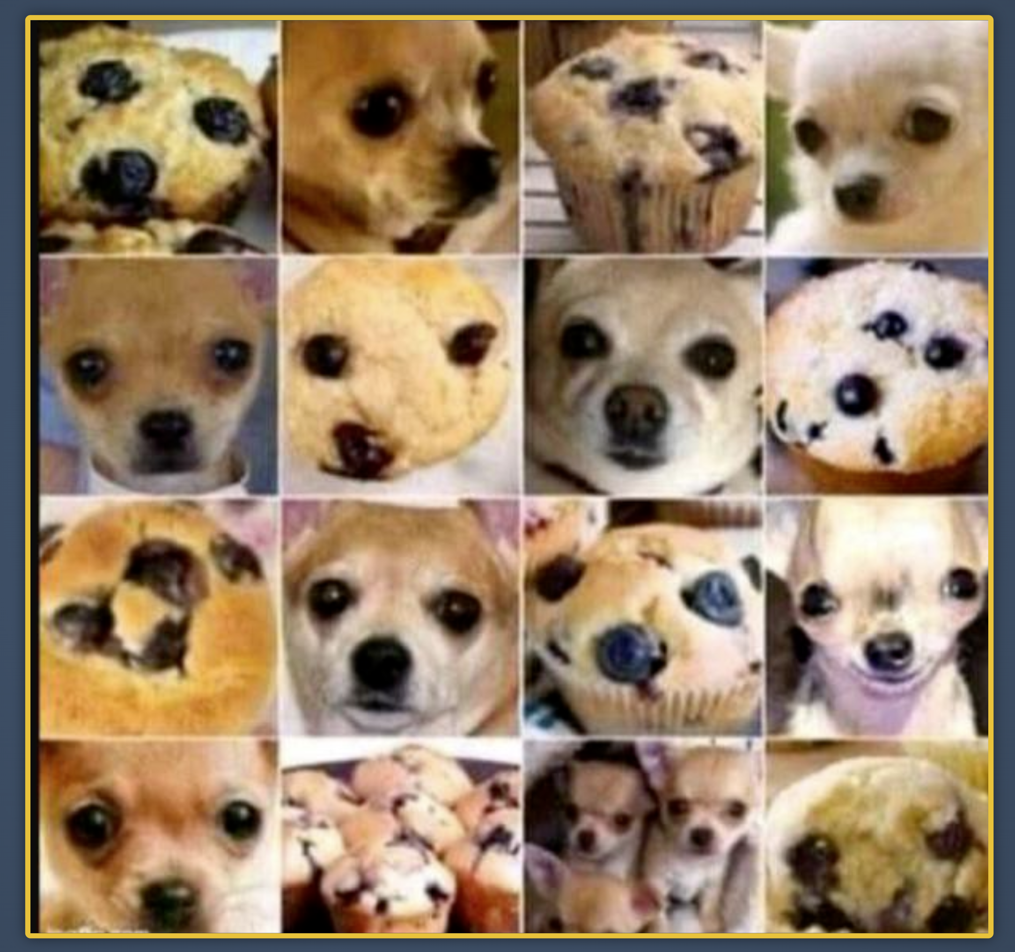
Notes:
https://bigdata-madesimple.com/machine-learning-explained-understanding-supervised-unsupervised-and-reinforcement-learning/

Slide 12
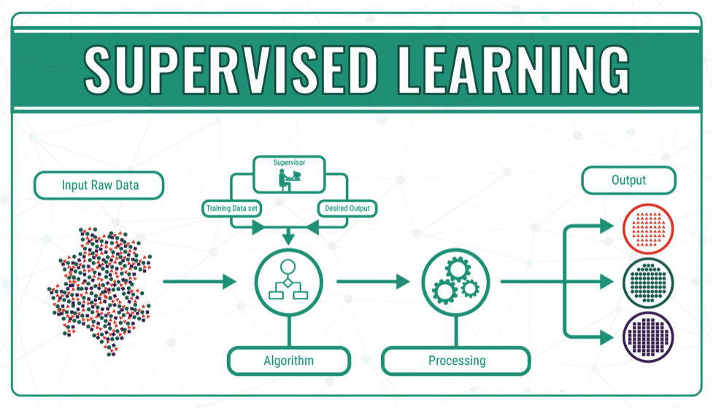
Notes:
https://bigdata-madesimple.com/machine-learning-explained-understanding-supervised-unsupervised-and-reinforcement-learning/

Slide 13
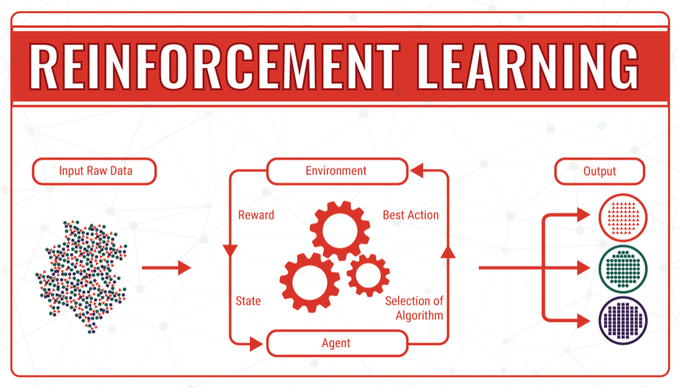
Notes:
https://bigdata-madesimple.com/machine-learning-explained-understanding-supervised-unsupervised-and-reinforcement-learning/

